Slide 1
The visual interface
Human Visual Perception

Slide 2
Learning outcomes
What are the two stages of the visual system?
How do luminance and colour effect visual perception?
What is the difference between central and peripheral vision?
How do we read?

Slide 3
How do we realize design?
What should we consider?
Technical
Visual
Interaction
Search
Context of use
Information
Interacting/ transacting

Slide 4
Realizing the visual interface
Human visual systems
Visual aesthetics
Grouping
Lines Borders & Tables
Text
Colour and Images
Forms and Controls

Slide 5
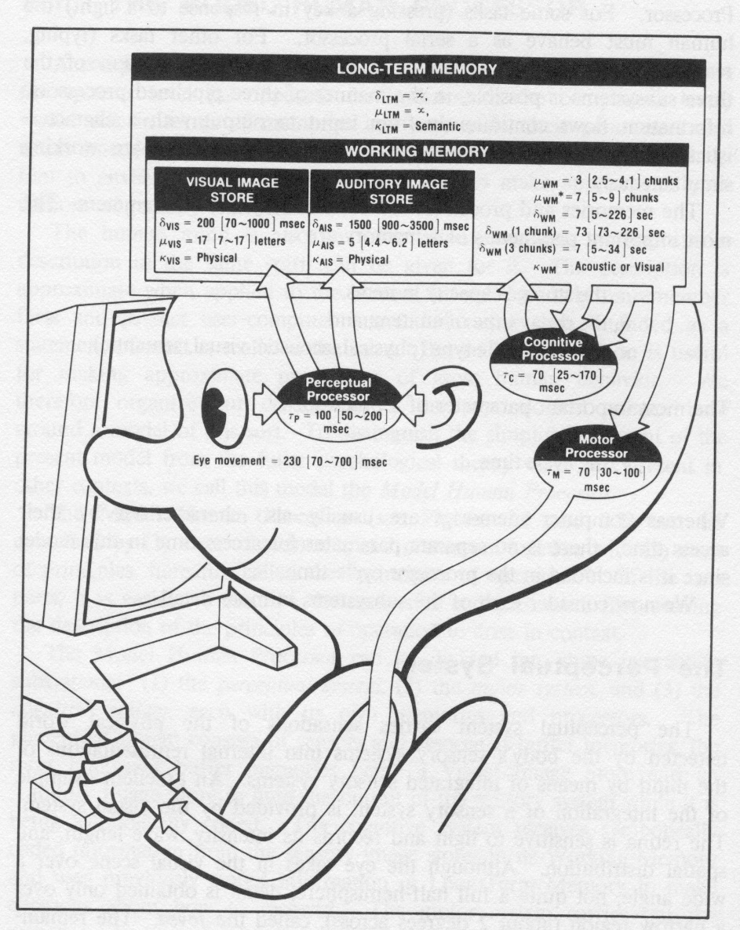
The human processor
Input
senses
Process
Cognition
Knowledge
Skills
Reasoning
Storage
Memory
Output
Actions
Speech

Slide 6
Senses
Computer devices
Input output
Human
Vision
Hearing
Smell
Taste
Touch
Kinaesthetic / proprioception

Slide 7
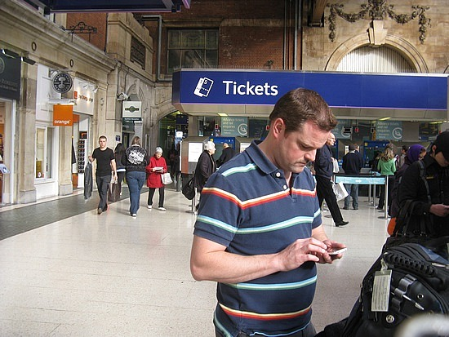




Current computer systems
Mostly output is to a visual display.
And the display is also the input medium on phones etc!
Exceptions
Sound
Vibrate

Slide 8
Vision
Two stages in vision
• physical reception of stimulus
• processing and interpretation of stimulus

Slide 9

The Eye - physical reception
mechanism for receiving light and transforming it into electrical energy
light
Reflects from objects (e.g. paper)
Or is produced from a light source (e.g. a display)
images are focused upside-down on retina
retina contains rods for low light vision and cones for colour vision
ganglion cells (brain!) detect pattern and movement
Interesting web site http://www.hhmi.org/senses

Slide 10

Interpreting the signal (cont)
Luminance (Brightness)
subjective reaction to levels of light
affected by luminance of object
visual acuity increases with luminance as does flicker
Colour
made up of hue, intensity, saturation
cones sensitive to colour wavelengths
blue acuity is lowest
8% males and 1% females colour blind are severely colour blind

Slide 11
Luminance (Brightness)
Rods provide low-light monotone (grey scale) vision. Rods are saturated in bright light and contribute little or nothing to what you see.
However the principles of brightness and contrast are equally important with colour vision.

Slide 12
Half Time Entertainment
https://www.youtube.com/watch?v=DCu1G2rxj5c
There are a few naughty words in this clip so if you are easily offended don’t watch.

Slide 13
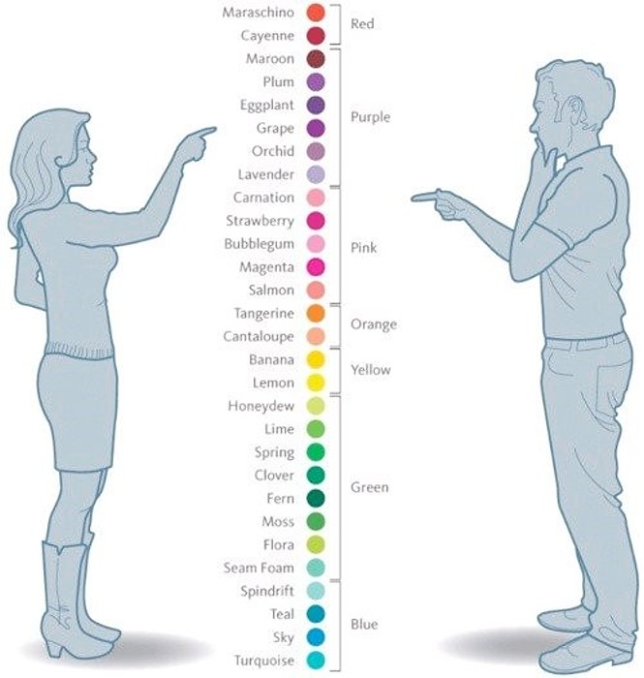
Colour and gender
Women see more colours than men (on average)
Perhaps 80% of men are colour blind .. depending on how you measure it. ☺
There is a difference between seeing the colours on a chart and seeing them in isolation

Slide 14
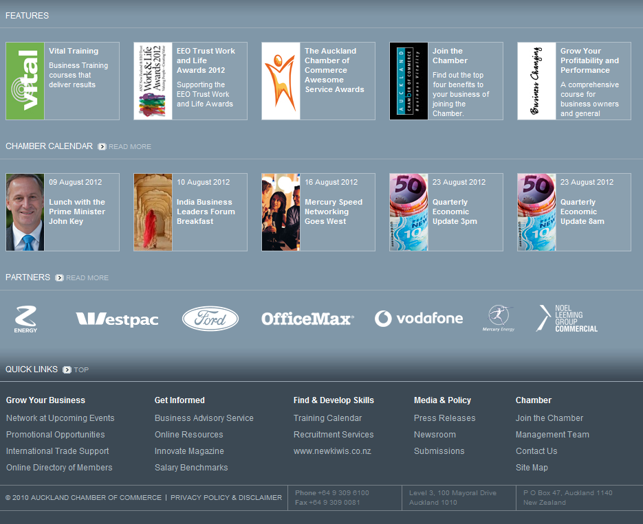
Oops

Slide 15
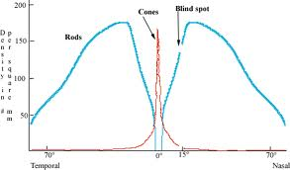
Central versus peripheral vision
Central
Peripheral
More cone cells
Better detail and focus
Less cells in general and more rod cells
Good movement detection

Slide 16
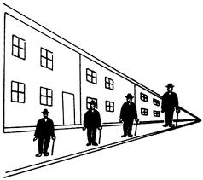
Interpreting the signal
Size and depth
visual angle indicates how much of view object occupies (relates to size and distance from eye)
visual acuity is ability to perceive detail (limited)
familiar objects perceived as constant size in spite of changes in visual angle when far away)
cues like overlapping help perception of size and depth
What does this mean for items on the screen periphery?

Slide 17
Interpreting the signal (cont)
The visual system compensates (to some degree) for:
movement
changes in luminance.
Context is used to resolve ambiguity
Optical illusions sometimes occur due to over compensation

Slide 18

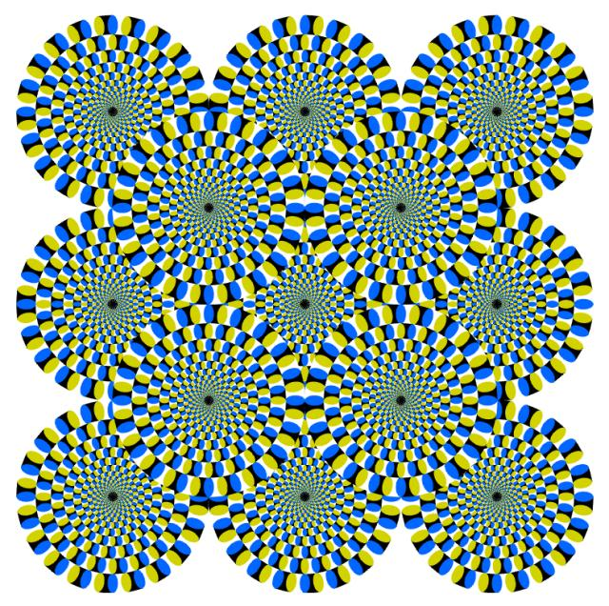
Optical Illusions
http://michaelbach.de/ot/

Slide 19
Reading
Several stages:
visual pattern perceived
decoded using internal representation of language
interpreted using knowledge of syntax, semantics, pragmatics
Reading involves saccades and fixations
Perception occurs during fixations
Word shape is very important to recognition
There are two main theories about how we read, one from psychology and one from typography… suffice to say, that either way the same things are important

Slide 20
Word shapes

Slide 21
When you are surfing the web this week
If you have trouble finding something you know must be on a page
Look to see why that is
Is it on an edge?
Is the colour wrong?
Is the font too small?
Put some examples up on the class forum – link and your comment as to what was good/bad about the visual layout
We will come back to the details for design over the next few lectures.

Slide 22
What if ….
Your visual attention is need for another activity
Driving & cell phone / gpa navigation….
Are colour blind?
Needed reading glasses?
Have really poor eye sight that cannot be corrected by glasses?
You are blind?

Slide 23
To be continued
Next lecture we’ll move from perception to aesthetics,
But don’t forget aesthetics is all based on our perception

